Slide 1


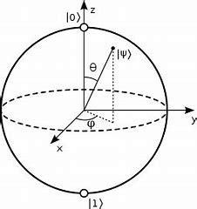

GSE Architecture and Innovation Working Group Belgium
Innovation with
Quantum Computing ?!
15th January 2020

Slide 2
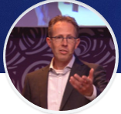
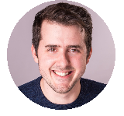
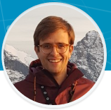
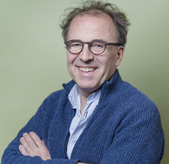
GSE Architecture and Innovation Working Group
The theme of today…
Innovation with
Quantum Computing ?!
Notes:
Quantum computing: theory till 80’s - Feynman
90’s: how to make it possible – DiVincenzo criteria
2004 – Quantum ElectroDynamics Circuit
2007 – Superconducting Transmon
2016 – IBM Q Experience
2019 – IBM Q System One
Qiskit
Growing Ecosystem
Optimization, Materials, Chemistry, AI, Medicines, …
Speakers

Slide 3
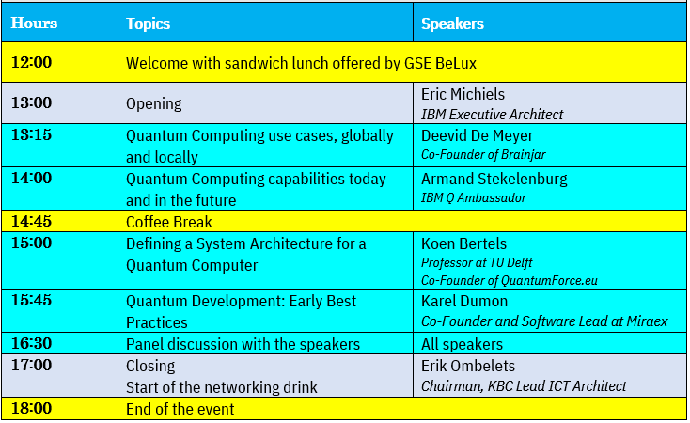
Agenda

Slide 4

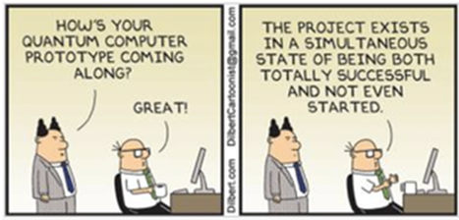

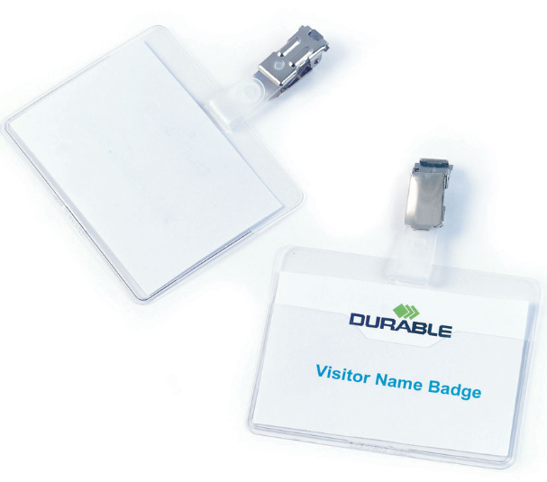

Enjoy your afternoon !
The Organizing Team
Wim Tobback
Erik Ombelets
Eric Michiels

Slide 5
10’

Slide 6
5’

Slide 7
1’

Slide 8
0’

Slide 9
Please drop your Badges here. Thanks !

Slide 10
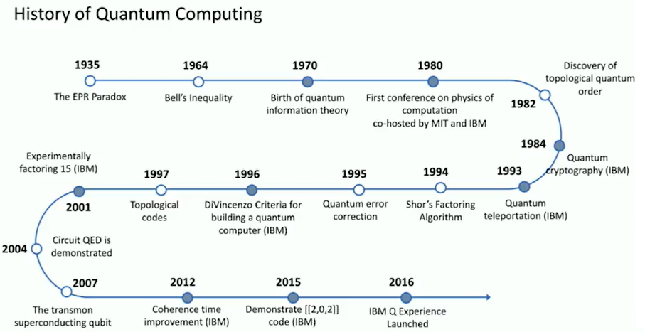
Event Brite
https://www.eventbrite.com/publish?crumb=6db0d2f19a5ded&eid=86268723073
Notes:
History
Until 80’s: theory (MIT, IBM) – Quantum Information Theory - Feynman
90’s: Shor, DiVincenzo criteria for building QC, How to correct errors
2004: Circuit QED demonstrations (Quantum ElectroDynamics)
2007: Superconducting Transmon
2016: IBM Q Experience, Composer,
Algorithms !
We see: Quantum Devices, Qiskit, Ecosystem
Optimization, Materials and Medecine Disovery, Chemistry, FSS,

Slide 11
Questions
What are the typical skills required for developing Quantum Algorithms? Which types of study would you recommend? Are they available in Belgium?
Will there be dedicated Quantum Software suppliers in the future? Will they be partners of the Mega-Cloud Platform Suppliers?
Is any Quantum research going on in Belgium? The Netherlands? Luxembourg? Is this only in Universities?
Is Belgian or Flemish Government or DoD thinking Quantum?
How is the point of view of European Union and ESA?
What would you recommend to do now in the area of Quantum Computing?
Google claimed “Quantum Supremacy”, but IBM reacted that the experiment was really specific and not solving a real world problem. What is your PoV?
What is the most objective way to measure the performance of Quantum Computers?
Which types of organizations do you as first users of Quantum Computing in Europe and Belgium? Concrete names?
What are your personal next ambitions in the area of Quantum?

Slide 12
Notes
………………………………………………………………………………………………………..
………………………………………………………………………………………………………..
………………………………………………………………………………………………………..
………………………………………………………………………………………………………..
………………………………………………………………………………………………………..
………………………………………………………………………………………………………..
………………………………………………………………………………………………………..
………………………………………………………………………………………………………..
………………………………………………………………………………………………………..

Slide 13
Please drop your Badges here. Thanks !

Slide 14
Please drop your Badges here. Thanks !

Slide 15
Please drop your Badges here. Thanks !

